Slide 1

CTD 26
KungFu Chess Server - Graphics

Slide 2
Graphics: Image – Color & Transparency
Paint.Net – See the pixels. XY Axes in an image / screen.
RGB – Playing with color. Memory layout.
Transparency – The 4th channel. Jpeg vs PNG. Bit depth.
Paint.Net – Layers, overlay, flattening
Paint.Net – Put_text

Slide 3
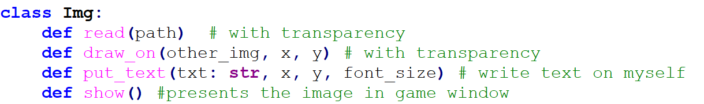
Graphics: Image – Color & Transparency
You are given:
1. Basic Image reading and presentation library (repo + example): 2. Animation images (a.k.a “Sprites”) in a predefined folder structure

Slide 4
Graphics: Animation
Animations Explained
Serial, sometimes Circular
FPS, definitions Json.
State Machine (Mindset)

Slide 5
Graphics: Animation
Game Controls
Mouse events
Relative window location and dynamic size
Screen pixels vs. image pixels
How to test yourself ?

Slide 6
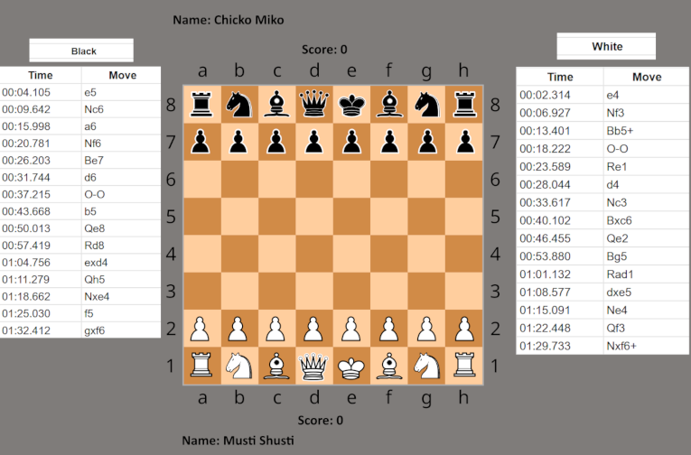
Additional Requirements
Moves log
Presenting score = “cost” of captured pieces.
Presenting player names
Observer

